Slide 1

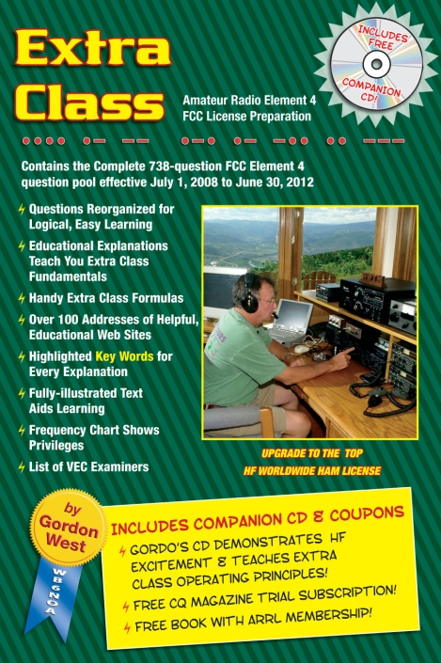
Amateur Extra Licensing Class
Amps & Power Supplies
Presented by
W5YI
Arlington, Texas

Slide 2
Amateur Radio Extra Class
Element 4 Course Presentation
ELEMENT 4 Groupings
  Rules & Regs
  Skywaves & Contesting
  Outer Space Comms
  Visuals & Video Modes
  Digital Excitement with Computers & Radios
  Modulate Your Transmitters
  Amps & Power Supplies
  Receivers with Great Filters

Slide 3
Amateur Radio Extra Class
Element 4 Course Presentation
ELEMENT 4 Groupings
  Oscillate & Synthesize This!
  Circuits & Resonance for All!
  Components in Your New Rig
  Logically Speaking of Counters
  Optos & OpAmps Plus Solar
  Test Gear, Testing, Testing 1,2,3
  Antennas
  Feedlines & Safety

Slide 4
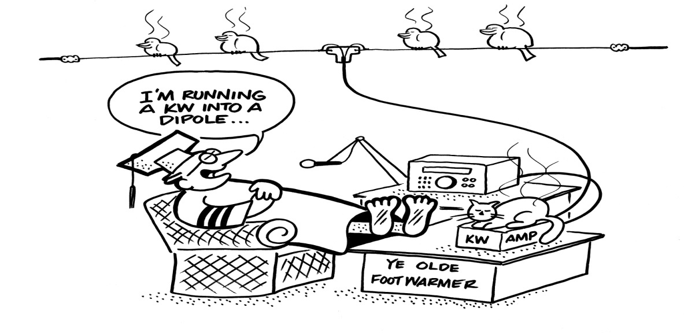
Amateur Radio Extra Class
Amps & Power Supplies
E1F04… If an external RF amplifier is listed on the FCC database as certificated for use in the amateur service, that particular RF amplifier may be marketed for use in the amateur service.
E1F05… A dealer may sell an external RF power amplifier capable of operation below 144 MHz if it has been granted FCC certification only if it was purchased in used condition from an amateur operator and is sold to another amateur operator for use at that operator's station.

Slide 5
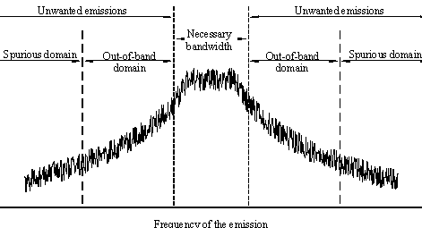
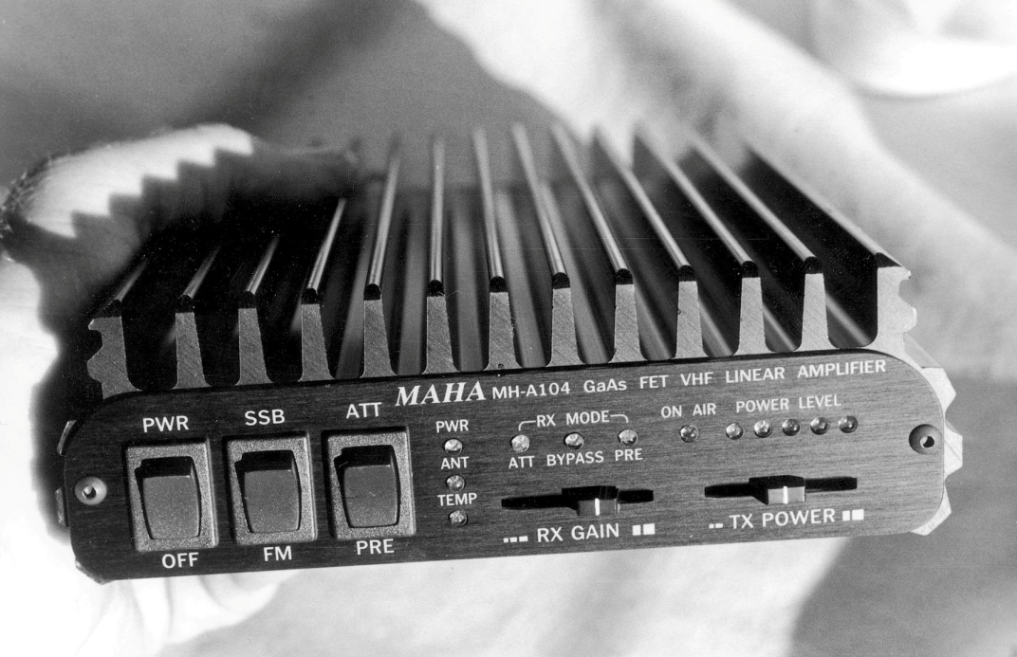

Amateur Radio Extra Class
Amps & Power Supplies
E1F14… An external RF power amplifier must satisfy the FCC's spurious emission standards when operated at its full output power in order to qualify for a grant of FCC certification.
2-meter linear power amplifier. Meets stringent FCC spurious emission standards.

Slide 6
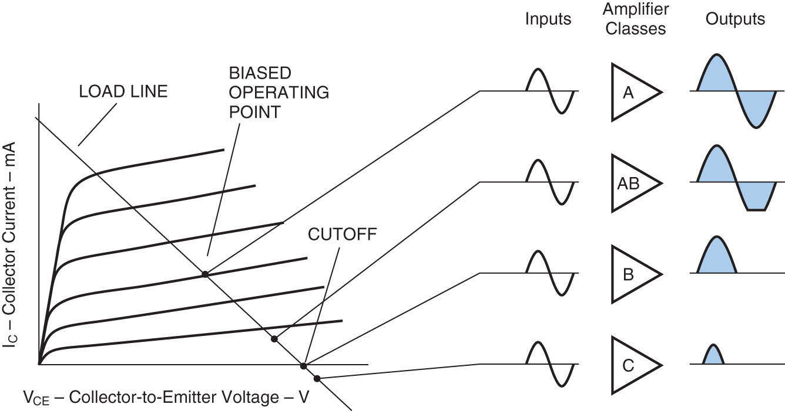
Amateur Radio Extra Class
Amps & Power Supplies
E8D03… The Peak voltage input-amplitude parameter is valuable in evaluating the signal-handling capability of a Class A amplifier.
E7B03… The bias point of a Class A common emitter amplifier would normally be set approximately half-way between saturation and cutoff.
E7B01… A Class AB amplifier operates over more than 180 degrees but less than 360 degree portion of a signal cycle.
Various Classes of Transistorized Amplifiers.

Slide 7
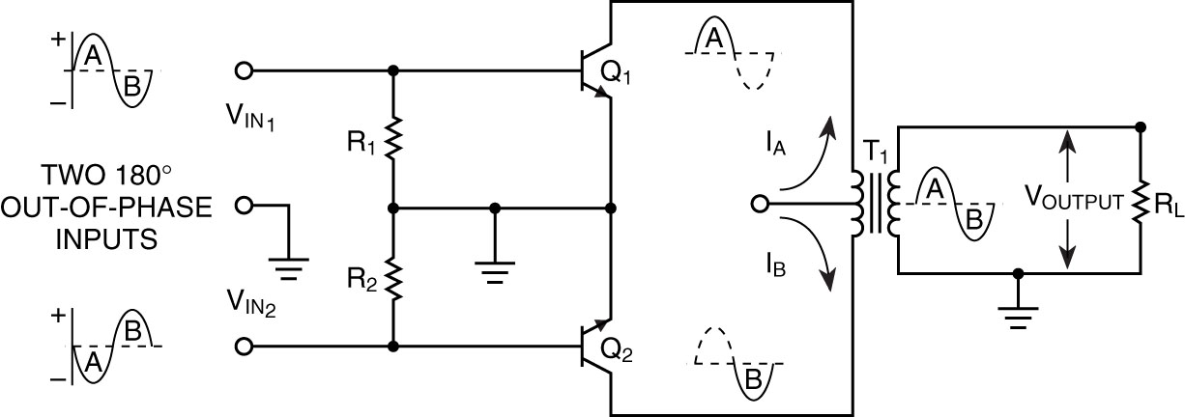
Amateur Radio Extra Class
Amps & Power Supplies
E1XXX… A push-pull type amplifier reduces or eliminates even-order harmonics.
E7B17… A grounded-grid amplifier has low input impedance.
E7B07… A vacuum-tube power amplifier can be neutralized by feeding back an out-of-phase component of the output to the input.

Slide 8
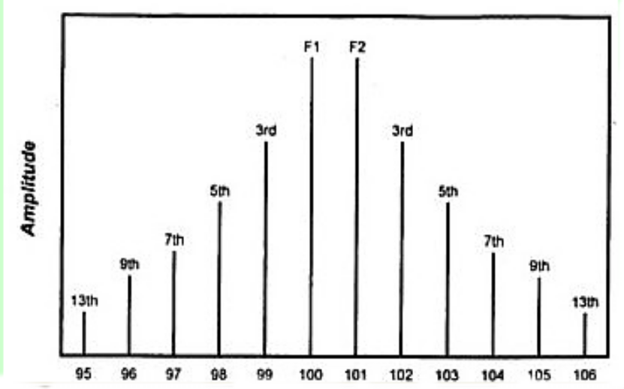
Amateur Radio Extra Class
Amps & Power Supplies
E7B16… Third-order intermodulation distortion products are of particular concern in linear power amplifiers because they are relatively close in frequency to the desired signal.
E7B04… To prevent unwanted oscillations in a power amplifier you will need to install parasitic suppressors and/or neutralize the stage.
E7B02… A Class C amplifier provides the highest efficiency.

Slide 9
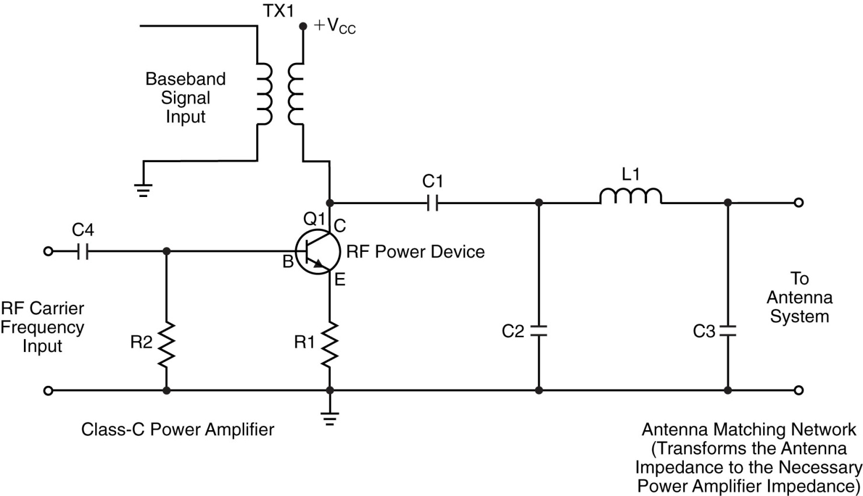
Amateur Radio Extra Class
Amps & Power Supplies
E7B06… When a Class C rather than a class AB amplifier is used to amplify a single-sideband phone signal the signal may become distorted and occupy excessive bandwidth.
Class-C power amplifier-modulator being modulated with baseband signal.

Slide 10
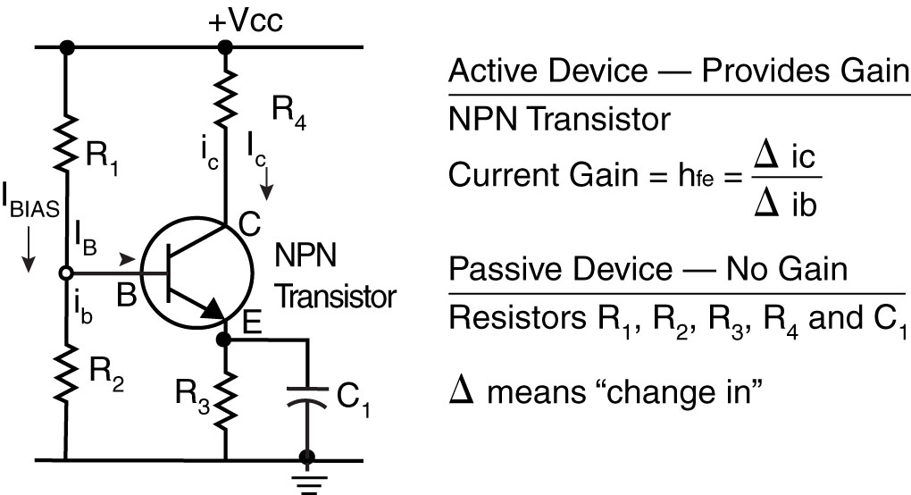
Amateur Radio Extra Class
Amps & Power Supplies
E7B20… A FET is generally best suited for UHF or microwave power amplifier applications.
E7B14… Using degenerative emitter feedback is one way to prevent thermal runaway in a transistor amplifier.
Small-signal amplifier with an NPN transistor as the active device and resistors and a capacitor as passive devices that set the “no-signal” (DC) operating point.

Slide 11
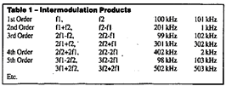

Amateur Radio Extra Class
Amps & Power Supplies
E6D11… Ferrite beads are commonly used as VHF and UHF parasitic suppressors at the input and output terminals of transistorized HF amplifiers.
E7B19… A parametric amplifier is a low-noise VHF or UHF amplifier relying on varying reactance for amplification.
E7B15… The effect of intermodulation products in a linear power amplifier is the transmission of spurious signals.

Slide 12
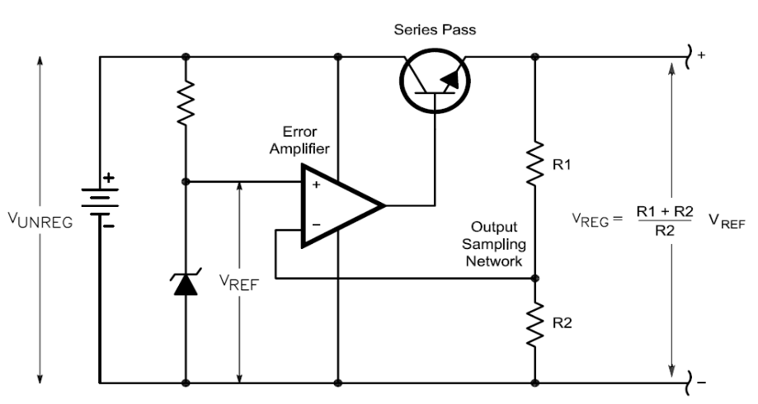
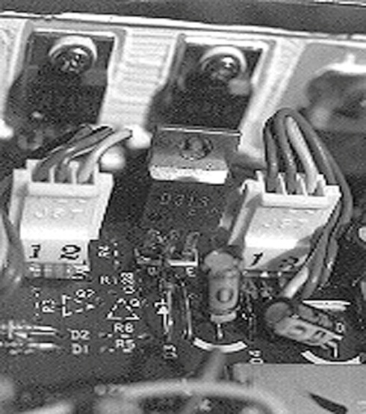
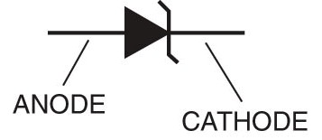
Amateur Radio Extra Class
Amps & Power Supplies
E7D01… One characteristic of a linear electronic voltage regulator is the conduction of a control element is varied to maintain a constant output voltage.
E7D03… A Zener diode is typically used as a stable reference voltage in a linear voltage regulator.
Schematic symbol of a Zener diode. Since a diode only passes energy in one direction, look for that one-way arrow, plus a “Z” indicating it is a Zener diode. Notice how the vertical line looks like a tiny “Z”.

Slide 13
Amateur Radio Extra Class
Amps & Power Supplies
E7D02… One characteristic of a switching electronic voltage regulator is the control device’s duty cycle is controlled to produce a constant average output voltage.
E7D04… A series regulator type of linear regulator makes the most efficient use of the primary power source.
E7D05… A shunt regulator type of linear voltage regulator places a constant load on the unregulated voltage source.

Slide 14
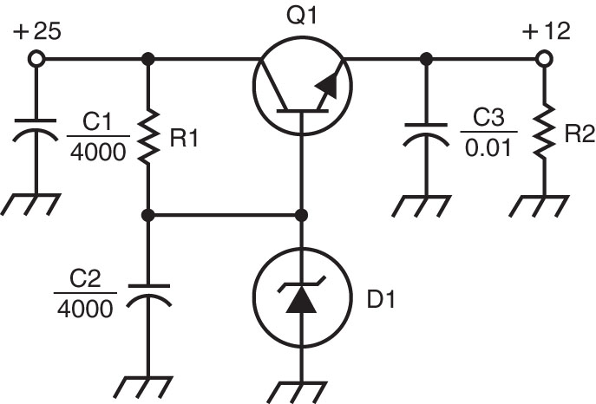
Amateur Radio Extra Class
Amps & Power Supplies
E7D06… The purpose of Q1 in the circuit shown in Figure E7-3 is to increase the current-handling capability of the regulator.
E7D07… The purpose of C2 in the circuit shown in Figure E7-3 is to bypass hum around D1.
E7D08… The circuit shown in Figure E7-3 is a linear voltage regulator.
E7D09… The purpose of C1 in the circuit shown in Figure E7-3 is to filter the supply Power voltage.
Figure E7-3

Slide 15
Amateur Radio Extra Class
Amps & Power Supplies
E7D10… The purpose of C3 in the circuit shown in Figure E7-3 is to prevent self-oscillation.
E7D11… The purpose of R1 in the circuit shown in Figure E7-3 is to It supply current to D1.
E7D12… The purpose of R2 in the circuit shown in Figure E7-3 is to provide a constant minimum load for Q1.
E7D13… The purpose of D1 in the circuit shown in Figure E7-3 is to provide a voltage reference.
Figure E7-3

Slide 16
Amateur Radio Extra Class
Amps & Power Supplies
E7D14… One purpose of a "bleeder" resistor in a conventional (unregulated) power supply is to improve output voltage regulation.
E7D15… The purpose of a "step-start" circuit in a high-voltage power supply is to allow the filter capacitors to charge gradually.
This consists of inserting a resistor in the primary side of the transformer to limit the charge current on the capacitors at initial turn on. The series resistor is switched out after a few seconds of operation.
E7D16… When several electrolytic filter capacitors are connected in series to increase the operating voltage of a power supply filter circuit, resistors should be connected across each capacitor to equalize, as much as possible, the voltage drop across each capacitor; to provide a safety bleeder to discharge the capacitors when the supply is off; and to provide a minimum load current to reduce voltage excursions at light loads. (Schematic next slide)

Slide 17
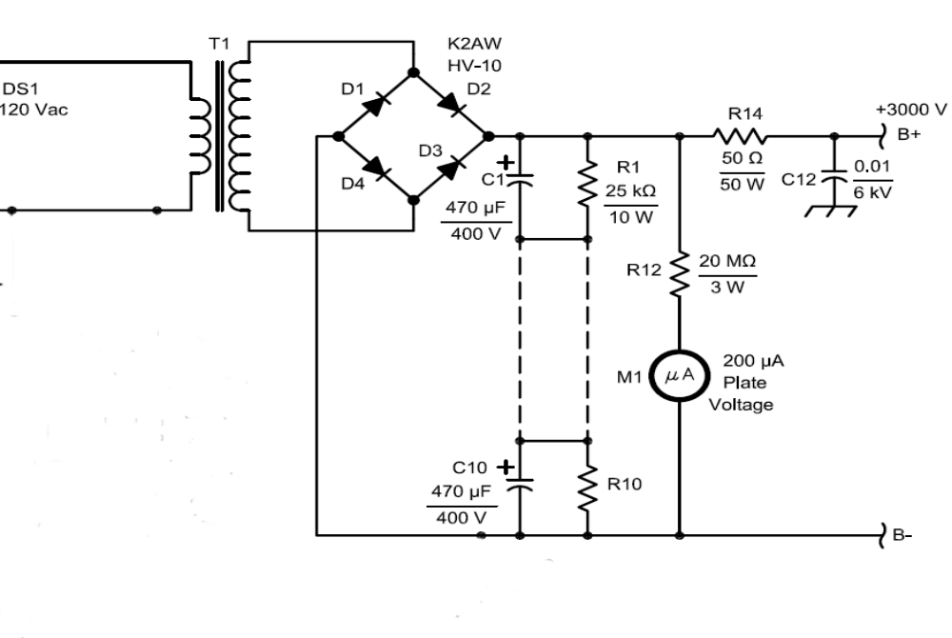
Amateur Radio Extra Class
Amps & Power Supplies
E7D17… The primary reason that a high-frequency inverter type high-voltage power supply can be both less expensive and lighter in weight than a conventional power supply is because the high frequency inverter design uses much smaller transformers and filter components for an equivalent power output.
Bleeder Resistors
Filter Capacitors in series.

Slide 18
Element 4 Extra Class
Question Pool
Amps & Power Supplies
Valid July 1, 2008
Through
June 30, 2012

Slide 19
E1F04What does it mean if an external RF amplifier is listed on the FCC database as certificated for use in the amateur service?
The RF amplifier may be marketed for use in any radio service
That particular RF amplifier may be marketed for use in the amateur service
All similar RF amplifiers produced by other manufacturers may be marketed
All RF amplifiers produced by that manufacturer may be marketed

Slide 20
E1F05 Under what circumstances may a dealer sell an external RF power amplifier capable of operation below 144 MHz if it has not been granted FCC certification?
It was purchased in used condition from an amateur operator and is sold to another amateur operator for use at that operator's station
The equipment dealer assembled it from a kit
It was imported from a manufacturer in a country that does not require certification of RF power amplifiers
It was imported from a manufacturer in another country, and it was certificated by that country’s government

Slide 21
E1F14 Which of the following best describes one of the standards that must be met by an external RF power amplifier if it is to qualify for a grant of FCC certification?
It must produce full legal output when driven by not more than 5 watts of mean RF input power
It must be capable of external RF switching between its input and output networks
It must exhibit a gain of 0 dB or less over its full output range
It must satisfy the FCC's spurious emission standards when operated at its full output power

Slide 22
E8D03 What input-amplitude parameter is valuable in evaluating the signal-handling capability of a Class A amplifier?
Peak voltage
RMS voltage
Average power
Resting voltage

Slide 23
E7B03 Where on the load line of a Class A common emitter amplifier would bias normally be set?
Approximately half-way between saturation and cutoff
Where the load line intersects the voltage axis
At a point where the bias resistor equals the load resistor
At a point where the load line intersects the zero bias current curve

Slide 24
E7B01 For what portion of a signal cycle does a Class AB amplifier operate?
More than 180 degrees but less than 360 degrees
Exactly 180 degrees
The entire cycle
Less than 180 degrees

Slide 25
E7B05 Which of the following amplifier types reduces or eliminates even-order harmonics?
Push-push
Push-pull
Class C
Class AB

Slide 26
E7B17 Which of the following is a characteristic of a grounded-grid amplifier?
High power gain
High filament voltage
Low input impedance
Low bandwidth

Slide 27
E7B07 How can a vacuum-tube power amplifier be neutralized?
By increasing the grid drive
By reducing the grid drive
By feeding back an out-of-phase component of the output to the input
By feeding back an in-phase component of the output to the input

Slide 28
E7B16 Why are third-order intermodulation distortion products of particular concern in linear power amplifiers?
Because they are relatively close in frequency to the desired signal
Because they are relatively far in frequency from the desired signal
Because they invert the sidebands causing distortion
Because they maintain the sidebands, thus causing multiple duplicate signals

Slide 29
E7B04 What can be done to prevent unwanted oscillations in a power amplifier?
Tune the stage for maximum SWR
Tune both the input and output for maximum power
Install parasitic suppressors and/or neutralize the stage
Use a phase inverter in the output filter

Slide 30
E7B02 Which class of amplifier, of the types shown, provides the highest efficiency?
Class A
Class B
Class C
Class AB

Slide 31
E7B06 Which of the following is a likely result when a Class C rather than a class AB amplifier is used to amplify a single-sideband phone signal?
Intermodulation products will be greatly reduced
Overall intelligibility will increase
Part of the transmitted signal will be inverted
The signal may become distorted and occupy excessive bandwidth

Slide 32
E7B20 Which of the following devices is generally best suited for UHF or microwave power amplifier applications?
FET
Nuvistor
Silicon Controlled Rectifier
Triac

Slide 33
E7B14 What is one way to prevent thermal runaway in a transistor amplifier?
Neutralization
Select transistors with high beta
Use degenerative emitter feedback
All of the above

Slide 34
E6D11 What devices are commonly used as VHF and UHF parasitic suppressors at the input and output terminals of transistorized HF amplifiers?
Electrolytic capacitors
Butterworth filters
Ferrite beads
Steel-core toroids

Slide 35
E7B19 What is a parametric amplifier?
A type of bipolar operational amplifier with excellent linearity derived from use of very high voltage on the collector
A low-noise VHF or UHF amplifier relying on varying reactance for amplification
A high power amplifier for HF application utilizing the Miller effect to increase gain
An audio push-pull amplifier using silicon carbide transistors for extremely low noise

Slide 36
E7B15 What is the effect of intermodulation products in a linear power amplifier?
Transmission of spurious signals
Creation of parasitic oscillations
Low efficiency
All of the above

Slide 37
E7D01 What is one characteristic of a linear electronic voltage regulator?
It has a ramp voltage as its output
It eliminates the need for a pass transistor
The control element duty cycle is proportional to the line or load conditions
The conduction of a control element is varied to maintain a constant output voltage

Slide 38
E7D03 What device is typically used as a stable reference voltage in a linear voltage regulator?
A Zener diode
A tunnel diode
An SCR
A varactor diode

Slide 39
E7D02 What is one characteristic of a switching electronic voltage regulator?
The resistance of a control element is varied in direct proportion to the line voltage or load current
It is generally less efficient than a linear regulator
The control device’s duty cycle is controlled to produce a constant average output voltage
It gives a ramp voltage at its output

Slide 40
E7D04 Which of the following types of linear regulator makes the most efficient use of the primary power source?
A constant current source
A series regulator
A shunt regulator
A shunt current source

Slide 41
E7D05 Which of the following types of linear voltage regulator places a constant load on the unregulated voltage source?
A constant current source
A series regulator
A shunt current source
A shunt regulator

Slide 42
E7D06 What is the purpose of Q1 in the circuit shown in Figure E7-3?
It provides negative feedback to improve regulation
It provides a constant load for the voltage source
It increases the current-handling capability of the regulator
It provides D1 with current

Slide 43
E7D07 What is the purpose of C2 in the circuit shown in Figure E7-3?
It bypasses hum around D1
It is a brute force filter for the output
To self-resonate at the hum frequency
To provide fixed DC
bias for Q1

Slide 44
E7D08 What type of circuit is shown in Figure E7-3?
Switching voltage regulator
Grounded emitter amplifier
Linear voltage regulator
Emitter follower

Slide 45
E7D09 What is the purpose of C1 in the circuit shown in Figure E7-3?
It resonates at the ripple frequency
It provides fixed bias for Q1
It decouples the output
It filters the supply voltage

Slide 46
E7D10 What is the purpose of C3 in the circuit shown in Figure E7-3?
It prevents self-oscillation
It provides brute force filtering of the output
It provides fixed bias for Q1
It clips the peaks of the ripple

Slide 47
E7D11 What is the purpose of R1 in the circuit shown in Figure E7-3?
It provides a constant load to the voltage source
It couples hum to D1
It supplies current to D1
It bypasses hum around D1

Slide 48
E7D12 What is the purpose of R2 in the circuit shown in Figure E7-3?
It provides fixed bias for Q1
It provides fixed bias for D1
It decouples hum from D1
It provides a constant minimum load for Q1

Slide 49
E7D13 What is the purpose of D1 in the circuit shown in Figure E7-3?
To provide line voltage stabilization
To provide a voltage reference
Peak clipping
Hum filtering

Slide 50
E7D14 What is one purpose of a "bleeder" resistor in a conventional (unregulated) power supply?
To cut down on waste heat generated by the power supply
To balance the low-voltage filament windings
To improve output voltage regulation
To boost the amount of output current

Slide 51
E7D15 What is the purpose of a "step-start" circuit in a high-voltage power supply?
To provide a dual-voltage output for reduced power applications
To compensate for variations of the incoming line voltage
To allow for remote control of the power supply
To allow the filter capacitors to charge gradually

Slide 52
E7D16 When several electrolytic filter capacitors are connected in series to increase the operating voltage of a power supply filter circuit, why should resistors be connected across each capacitor?
To equalize, as much as possible, the voltage drop across each capacitor
To provide a safety bleeder to discharge the capacitors when the supply is off
To provide a minimum load current to reduce voltage excursions at light loads
All of these answers are correct

Slide 53
E7D17 What is the primary reason that a high-frequency inverter type high-voltage power supply can be both less expensive and lighter in weight than a conventional power supply?
The inverter design does not require any output filtering
It uses a diode bridge rectifier for increased output
The high frequency inverter design uses much smaller transformers and filter components for an equivalent power output
It uses a large power-factor compensation capacitor to create "free" power from the unused portion of the AC cycle

